Slide 1

RoboReviews
How to Cut Costs in a Multi-Million Dollar Business
by Karel and Piero

Slide 2
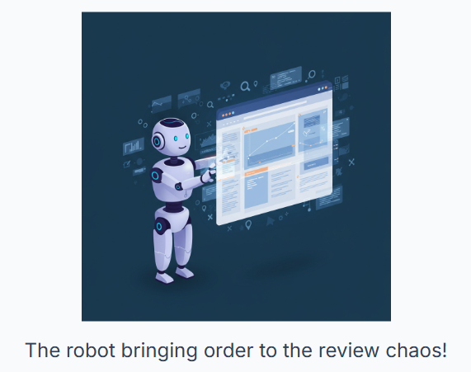

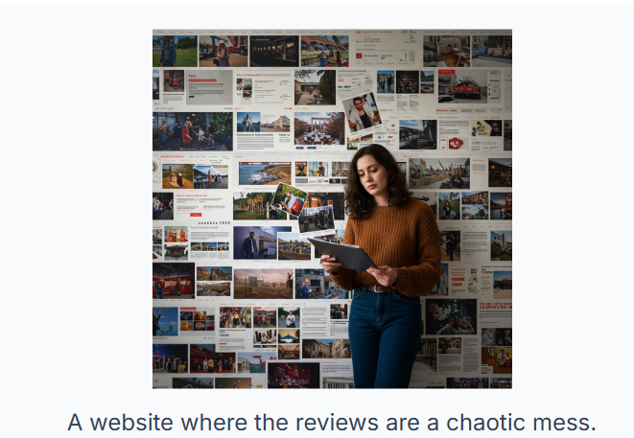
The Problem & The Opportunity
We receive millions of product reviews across thousands of products.
A team of 200 people processes these reviews manually — high cost.
Customers typically focus on the top 3 reviews when making purchase decisions.
Instead of reading for hours, they decide in minutes — if the best reviews are surfaced.

Slide 3
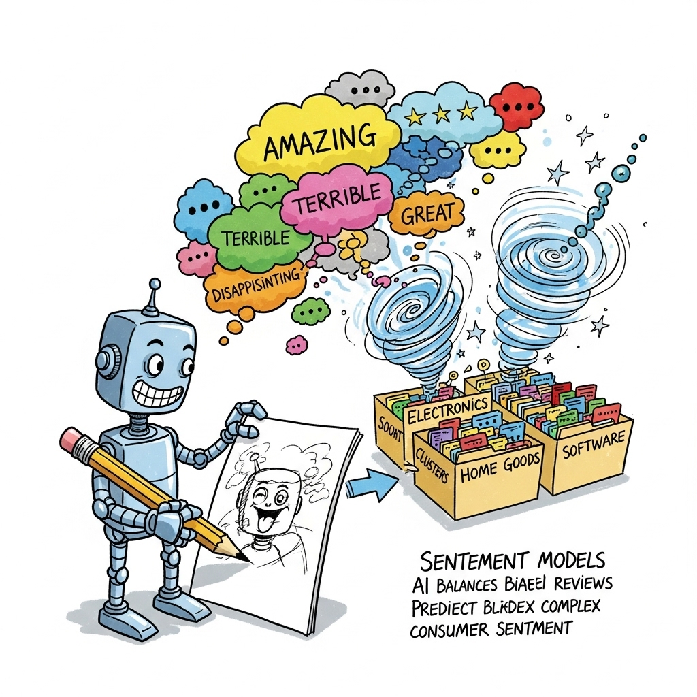
What we Achieved:
✅ Balance biased reviews using sentiment models that predict even complex cases.
✅ Cluster products into better categories automatically.
✅ Use AI to summarize reviews into concise, tech-oriented insights.

Slide 4
How and What we did:
1️⃣ Sentiment Analysis (TF-IDF + Random Forest): Classifies each review as positive, negative, or neutral — balances out misleading reviews.
2️⃣ Clustering (KMeans): Groups products into meaningful, extraction of categories via Unsupervised Learning.
3️⃣ LLM Summarization (GPT-3.5-turbo): Generates concise, tech-oriented summaries (Prompt- Engineering) for the top (N, we chose 3) products in each category.

Slide 5
TL;DR
Pipeline Overview:
1️⃣ Sentiment Classification: TF-IDF + Random Forest
2️⃣ Clustering: TF-IDF embeddings + KMeans clustering
3️⃣ Summarization: GPT-3.5-turbo model for tech-oriented product summaries
4️⃣ Final Aggregation: Top products selected by positive sentiment frequency and enriched with metadata
Our Methodology in One Sentence: “We combine classical ML and state-of-the-art LLMs in a multi-step pipeline to turn raw reviews into actionable product insights.”

Slide 6
Methods: From Raw Data to Insights
Combined Dataset
Datafiniti_Amazon_Consumer_Reviews_of_Amazon_Products
Datafiniti_Amazon_Consumer_Reviews_of_Amazon_Products_May19
1429_1
Duplication removal:
'reviews.text', 'reviews.username', 'asins'
Data Cleaning:
text = text.lower() # lowercase
text = re.sub(r"<.*?>", " ", text) # remove HTML tags
text = re.sub(r"[^\w\s]", " ", text) # remove punctuation
text = re.sub(r"\s+", " ", text) # remove extra whitespace

Slide 7
Sentiment Analysis:
How can we automatically classify customer reviews as positive, neutral, or negative?
Preprocessed review text (cleaning, tokenizing)
Tried: ✅ TextBlob (rule-based sentiment polarity) ✅ TF-IDF + Logistic Regression (baseline supervised model) ✅ TF-IDF + Random Forest (final choice for better performance)

Slide 8
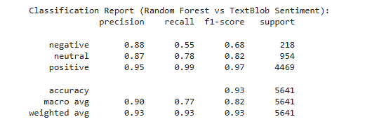
Sentiment Analysis: Evaluation
How We Measured Performance?
Confusion Matrix
Classification Report (Precision, Recall, F1)
Results: ✅ High accuracy on positive and negative reviews ⚠️ Slightly lower precision for neutral (class imbalance)
Why It Works:
TF-IDF + Random Forest generalize well across diverse product reviews
Captures key sentiment indicators (e.g., "great", "disappointed")

Slide 9
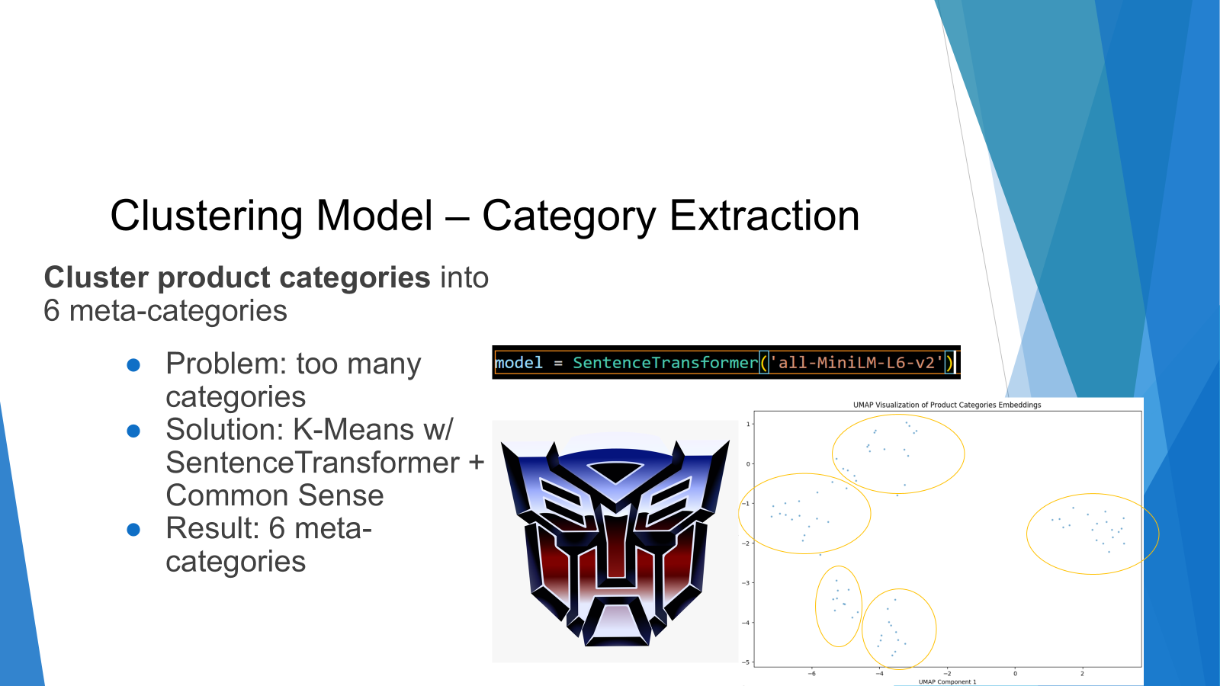
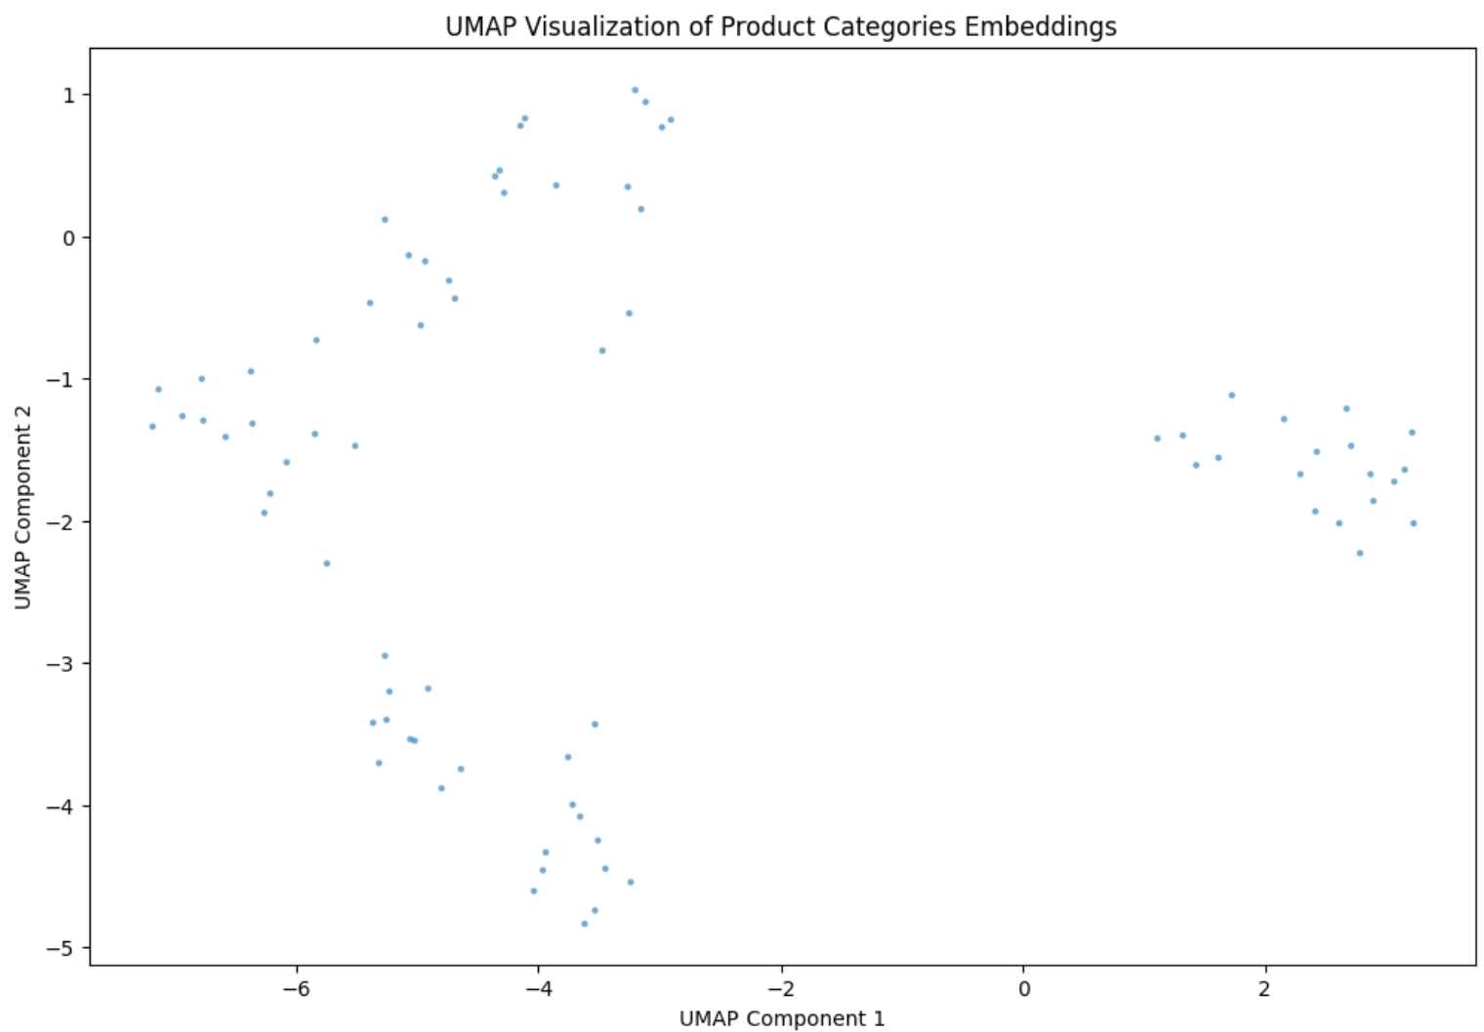
Clustering Model – Category Extraction
Cluster product categories into just 4-6 of them
Problem: too many different categories
Solution: K-Means w/ SentenceTransformer + Common Sense

Slide 10
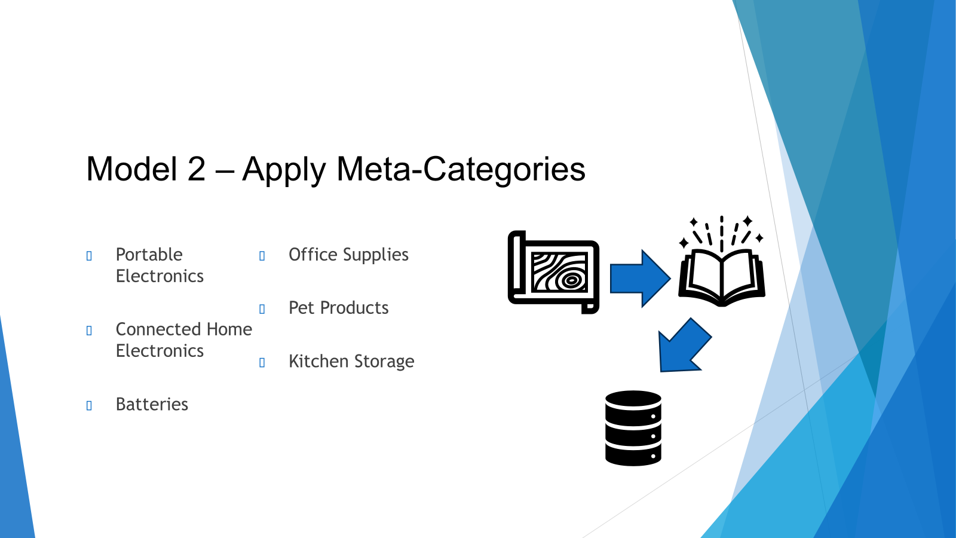
Model 2 - Evaluation
Cluster product categories into just 4-6 of them
Compare the results you have for evaluation
Show us why this works!
If you evaluation is complicated, explain us what you did

Slide 11

Model 3: Score top 3 + create summaries
Collected the top positively-reviewed products per category
Scoring algo: 40/30/20/10 of avg rating, review sentiment, recommendations, helpfulness
Used GPT-3.5-turbo to generate short, tech-focused summaries
Prompted the model with all the available reviews per product
40 | 30 | 20 | 10
avg rating | sentiment (RF-model) | Recommendations | Helpfulness

Slide 12
Model 3 - Evaluation
Spotchecks (Manual Revision)
Rouge Analysis
lack of reference texts
meaningful interpretation challenging

Slide 13
Conclusions
Built an NLP-powered review aggregator that: → Classifies sentiment (positive, neutral, negative) → Clusters product categories into meta-groups → Summarizes customer opinions using Generative AI
Medal : Extensive calculation to find the top 3 products

Slide 14

IT'S DEMO TIME!!!
It’s DEMO TIME!
LINK HERE

Slide 15
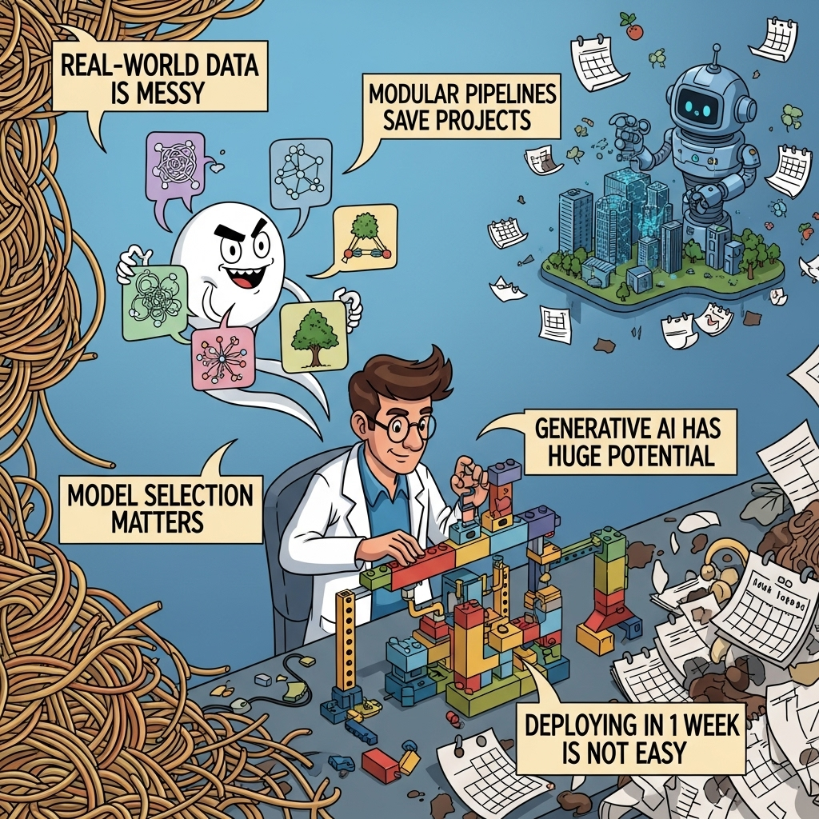
Key Learnings
Real-World Data is Messy
Model Selection Matters.
Modular Pipelines Save Projects.
Generative AI Has Huge Potential (the right prompt at the right time).
Cooperation matters.
Deploying in 1 week is not easy.

Slide 16
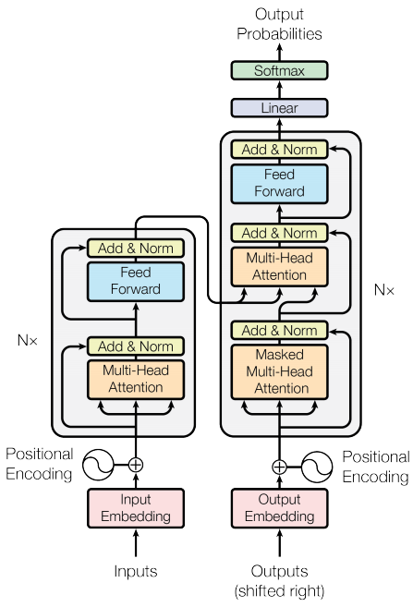
Thank you for
your attention.

